Slide 1
Framework Integrated Sensor Hybrid
By Jacob champion

Slide 2
Implementation
Laser (hologram) projected pellets will be created inside a tank to represent players. The fish will be fooled into thinking this is food but will chase by using they're in built-detection Sensors called the lateral line. A system of sensory organs found in fish that are used to sense movement, pressure levels, and vibrations in the surrounding water they are in.
Multiple cameras will be capturing the fish from different angles, which then turn it into a 3d model for implementation.

Slide 3
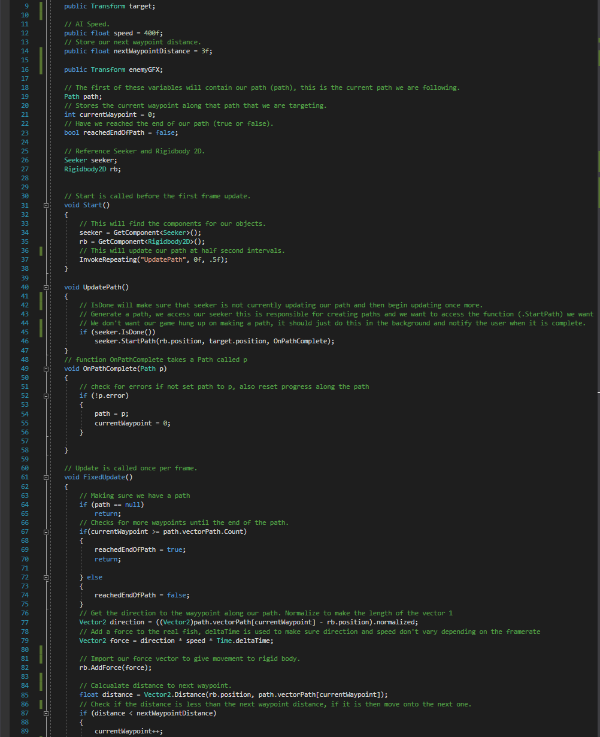
Unity Implementation
In this script, I program the real fish to chase the player fish around the tank.

Slide 4
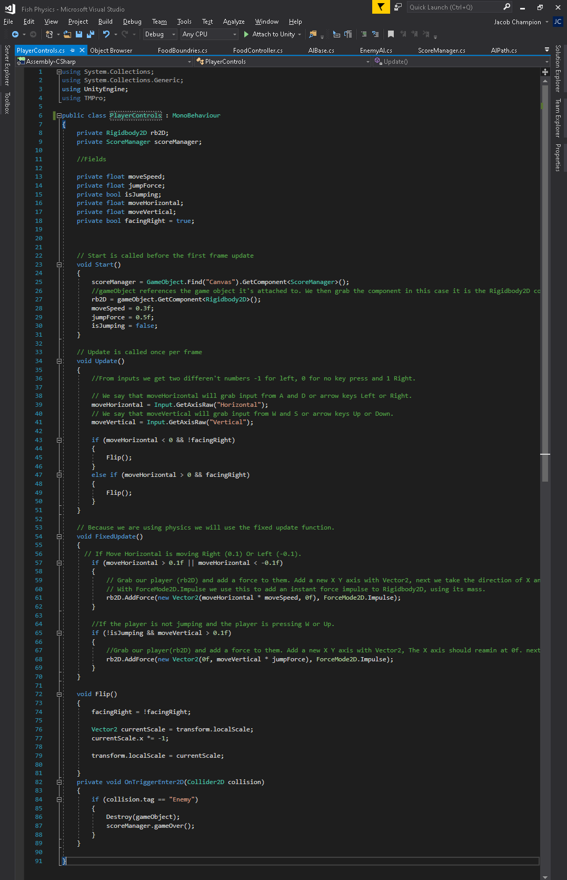
Unity Implementation
In this script, I program the real fish to chase the player fish around the tank.

Slide 5
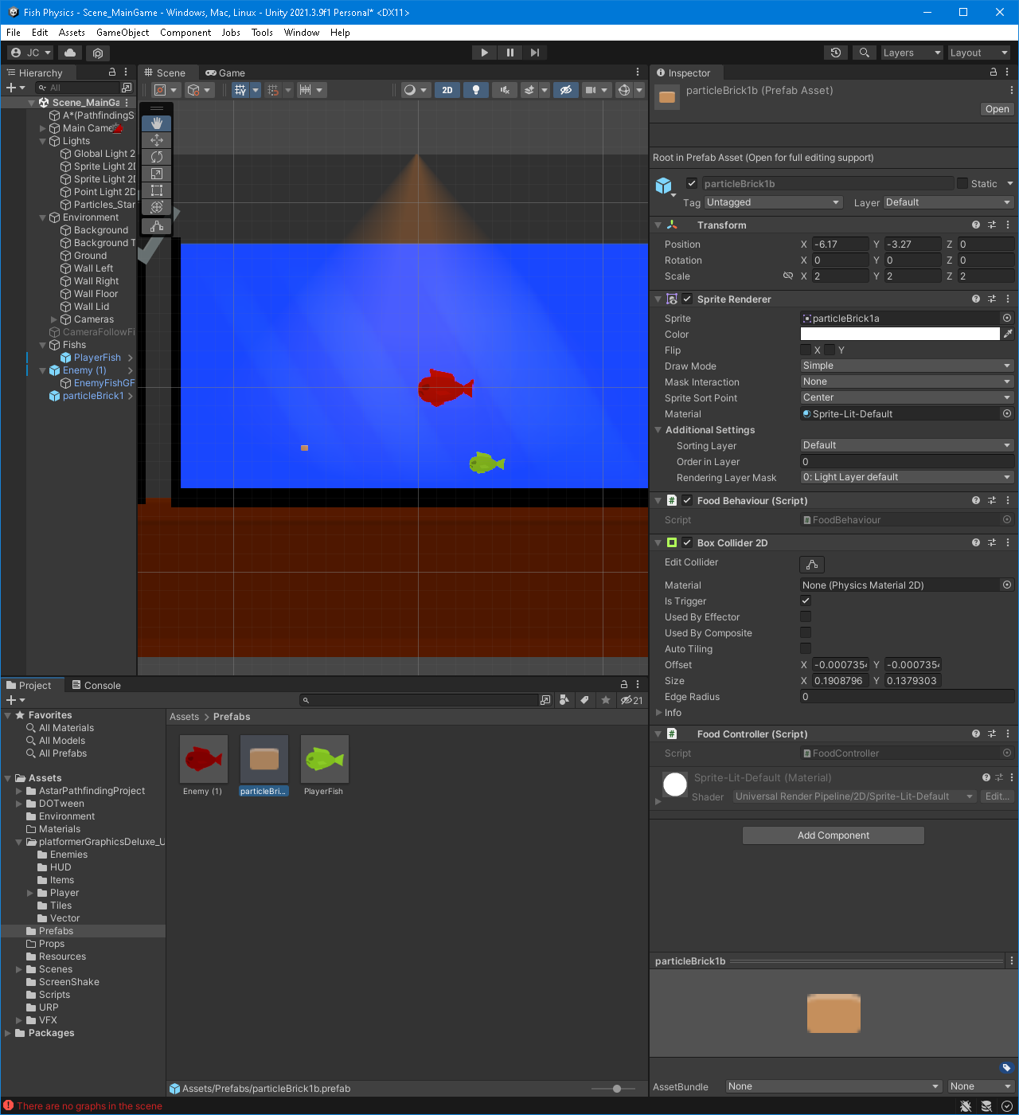
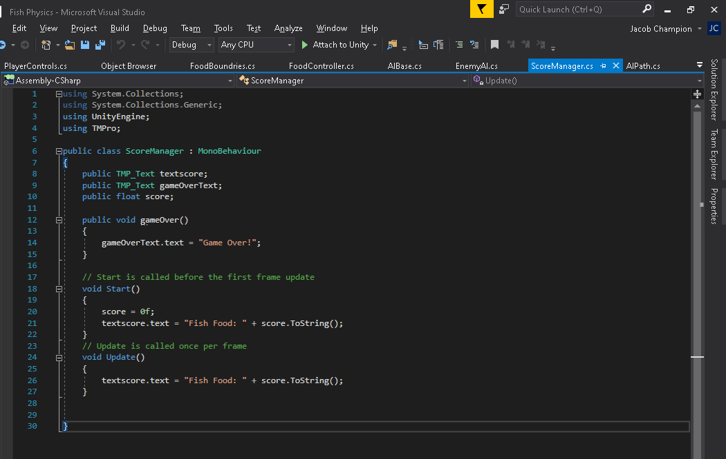
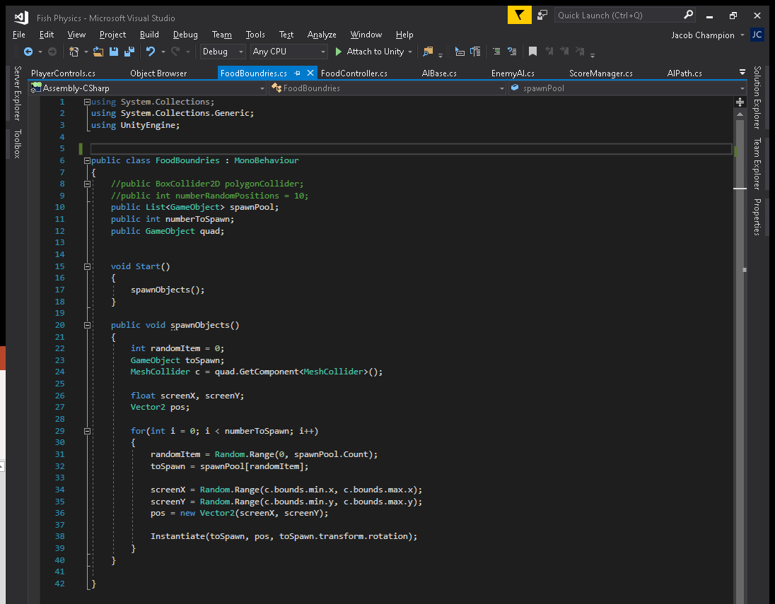
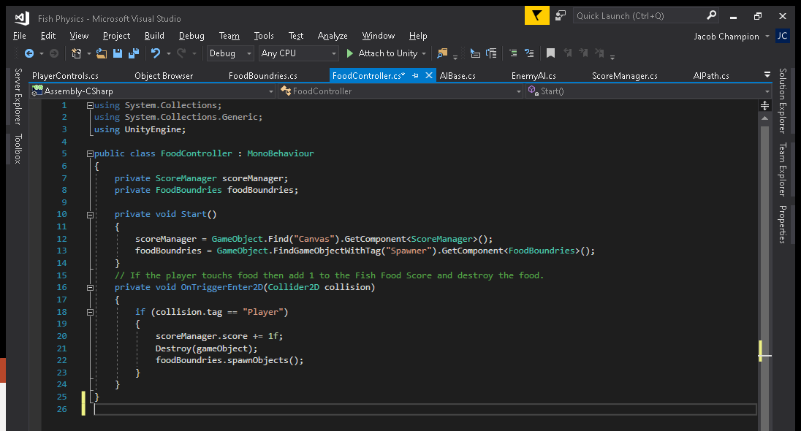
Unity - Implementation
Creation of a UI to save the score and a function used by the player script, to let the player know when the game is over!
Creation of prefabs to save time creating the same players, enemies, or items.
Here we assign this script to a quad so the food spawns in the correct place.
This script attached to the food will update the UI and destroy/create another piece of food.

Slide 7
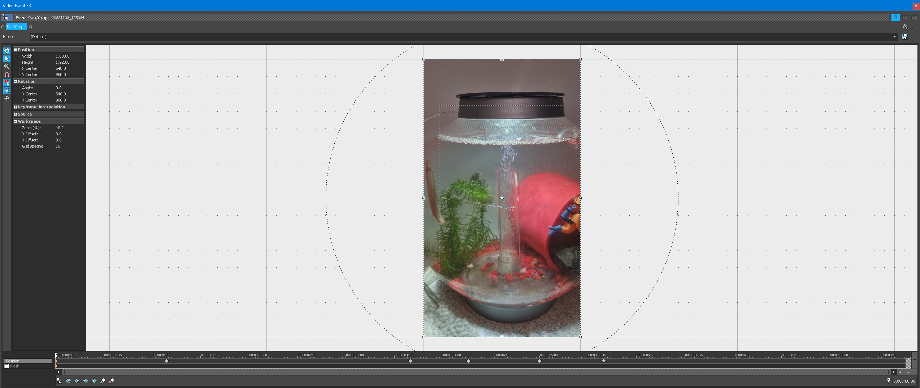
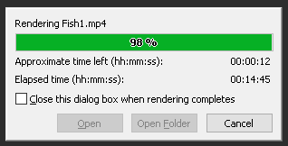
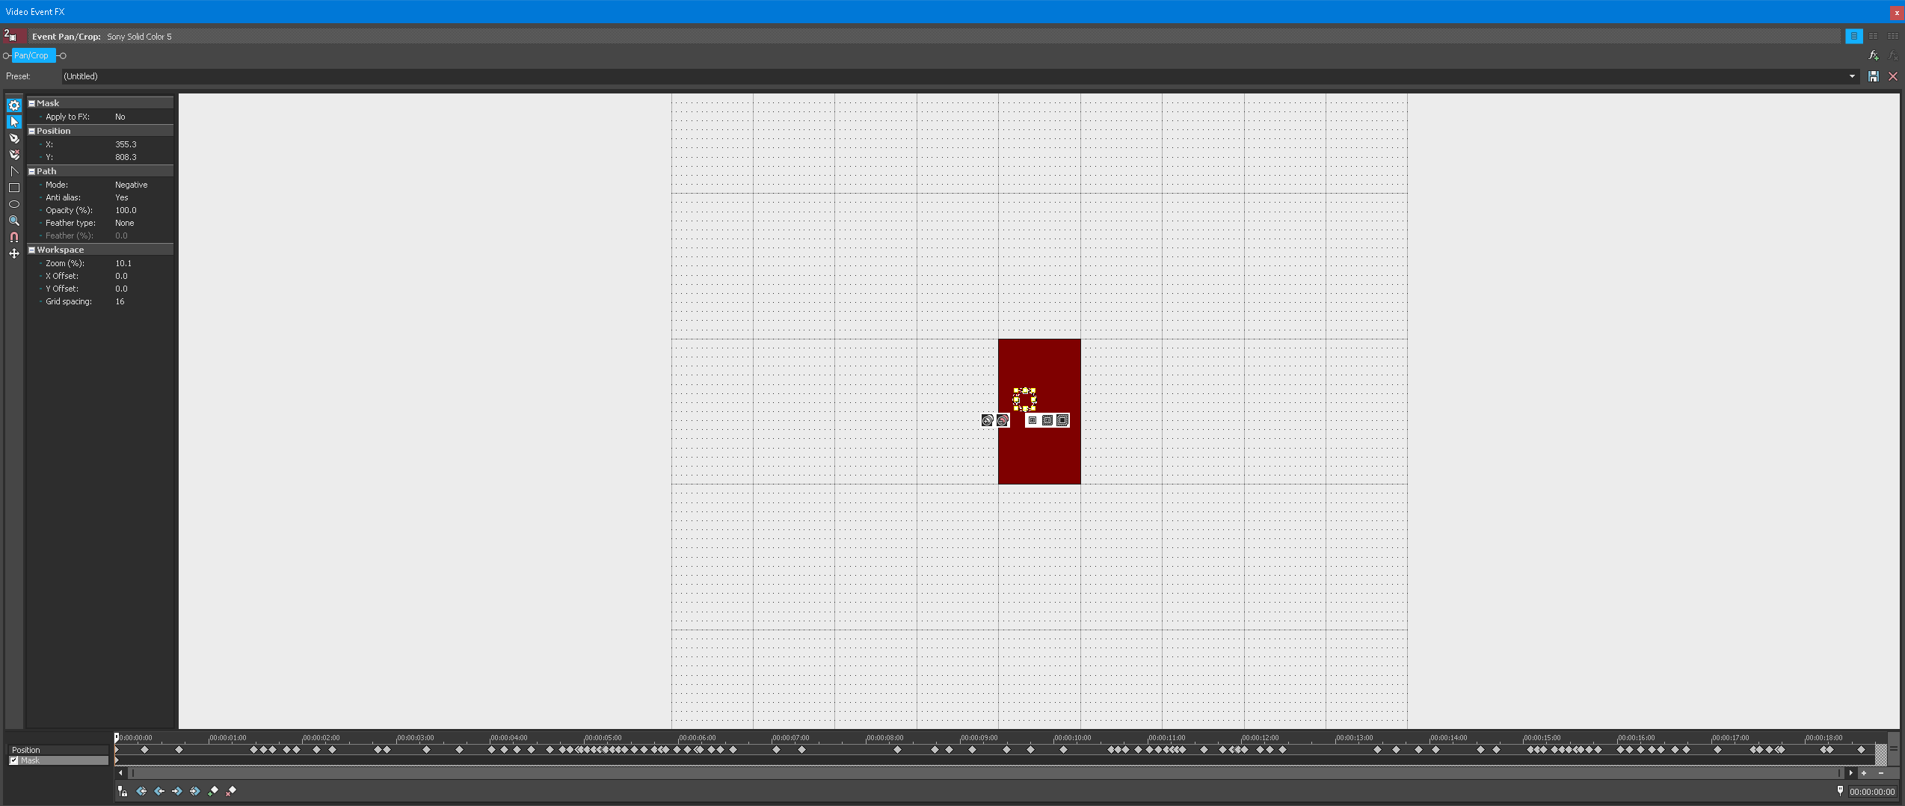
Documentation Sony Vegas
Cropping & Camera Stabilization.

Slide 8
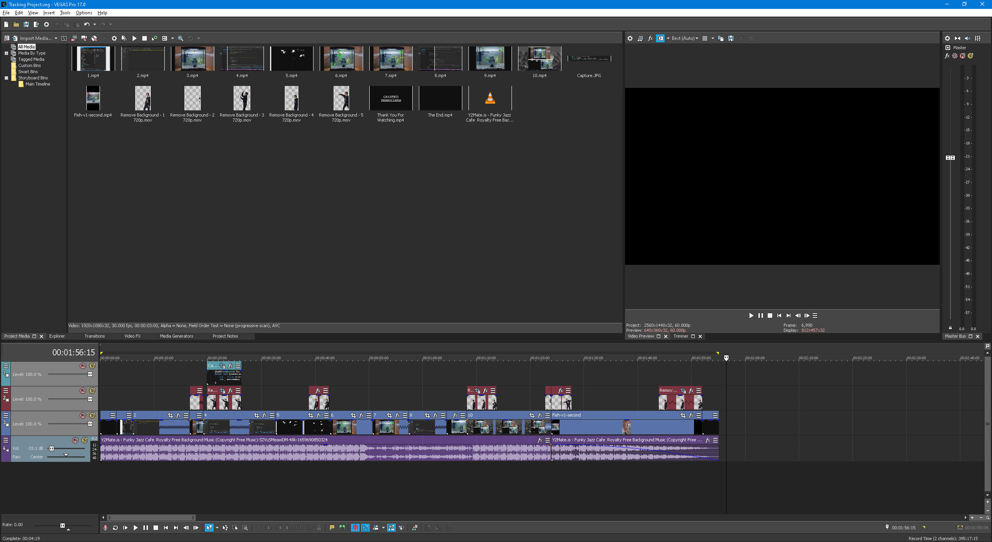
Documentation Sony Vegas

Slide 10

What possibilities exist with this technology?
Pets could act as AI enemies?
Bring creative worlds more life?
Instead of a multilayer game with family and friends what about your pet?
Bring pets with you in AR?

Slide 11
Fish Longevity
Correct PH water parameters.
Attention to fish themselves.
Fish live for the noms (food) and will never turn them down = reliability.

